Slide 1
Twitter Analysis of the Indian Elections 2019

Slide 2
Team Members:
Muhammad Usman Khan - 13107
Hasan Zafar – 13105
Zurayz Zia - 13185
Syed Muhammad Murtaza Kamal - 13090

Slide 3
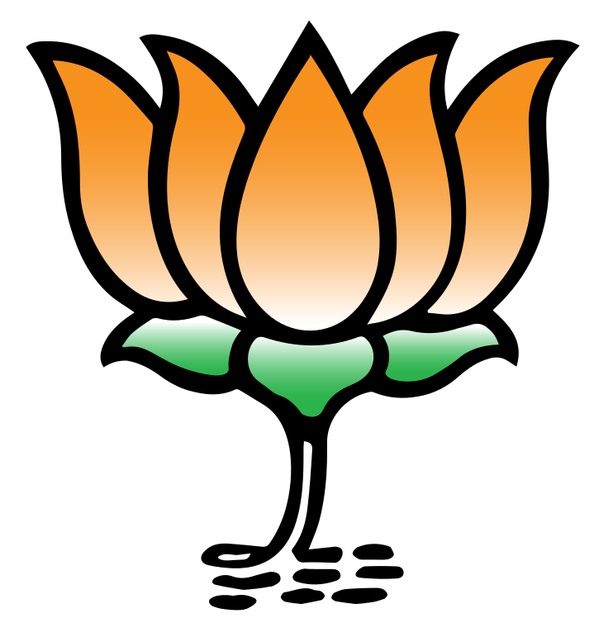
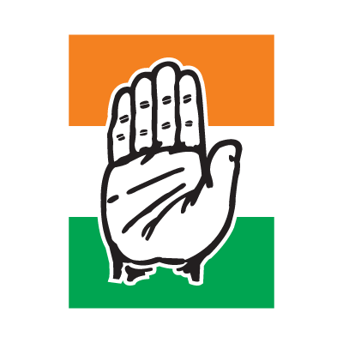
Business understanding
Identifying whether twitter is a credible source for analyzing the political climate of India.
Analyzing the position of the 2 major parties present in India: BJP and Congress.
Predicting the result of Indian Election 2019

Slide 4
Data Understanding
Data retrieval using Tweepy & Twitter Search API
We had a total of 50,000 extracted tweets. 25000 each of the hashtags #BJP and #Congress
These tweets constituted for less than 4% of the total Indian Population (limitation)
Our data contains tweets from 26th April 2019 to 4th May 2019

Slide 5
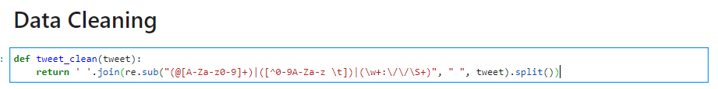
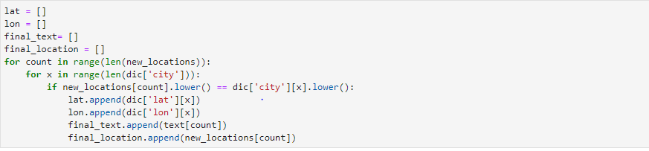
Data Preparation
Stopword Removal (from wordcloud library)
Data cleaning by removing mentions:
By removing null values and empty strings

Slide 6
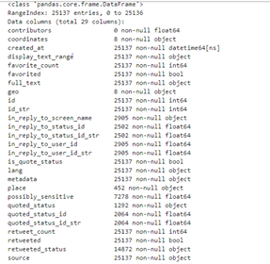
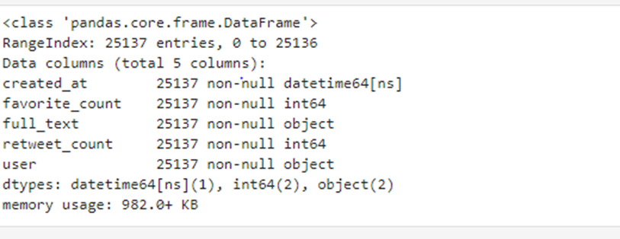
Removing unnecessary columns
Before
After

Slide 7
Modelling
We performed the following on our dataset:
K-Means Clustering
Frequency Analysis
Time – Series Analysis
Sentiment Analysis

Slide 8
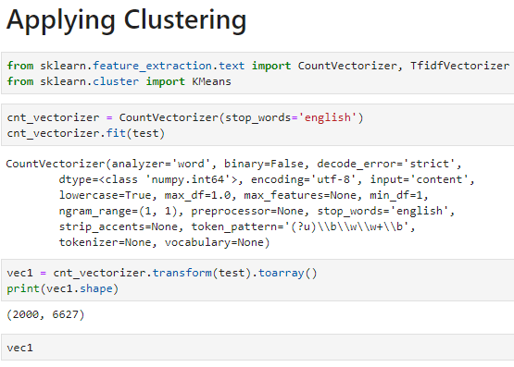
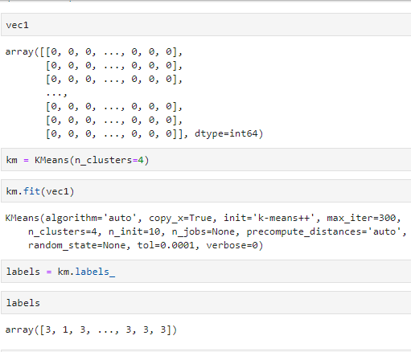
K Means Clustering

Slide 9
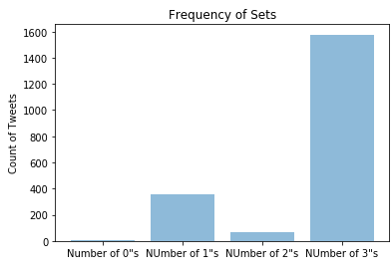
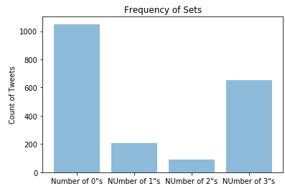
Frequency of each Clusters
BJP
Congress

Slide 10
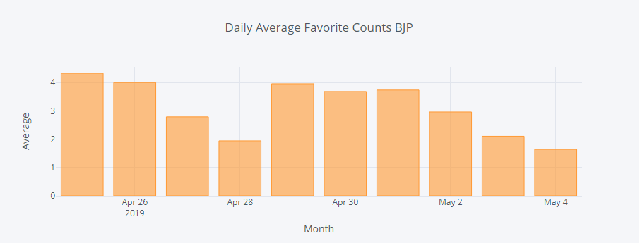
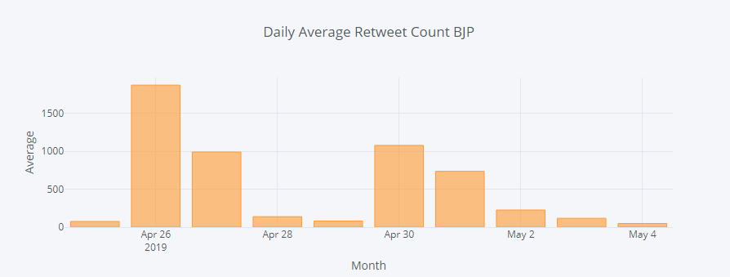
Daily Average Retweet/Favorite Counts for BJP

Slide 11
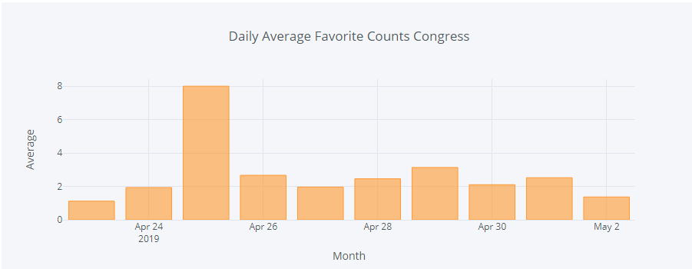
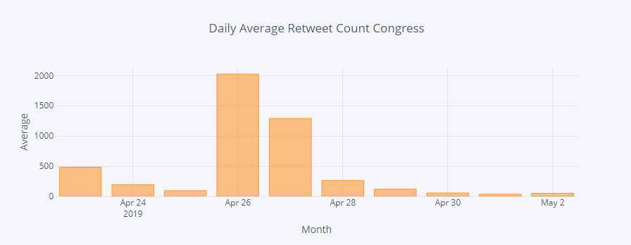
Daily Counts for Congress

Slide 12
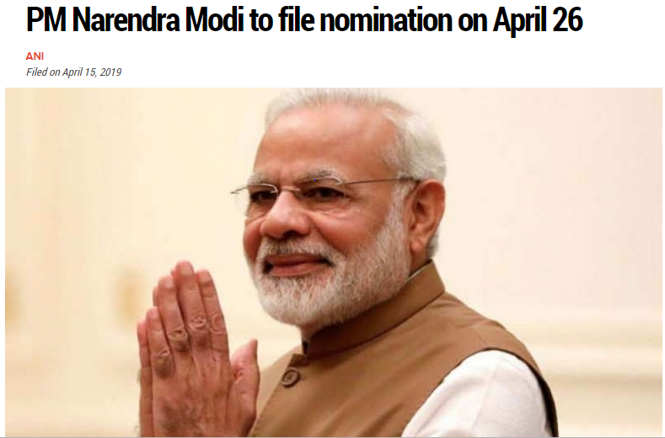

Slide 13
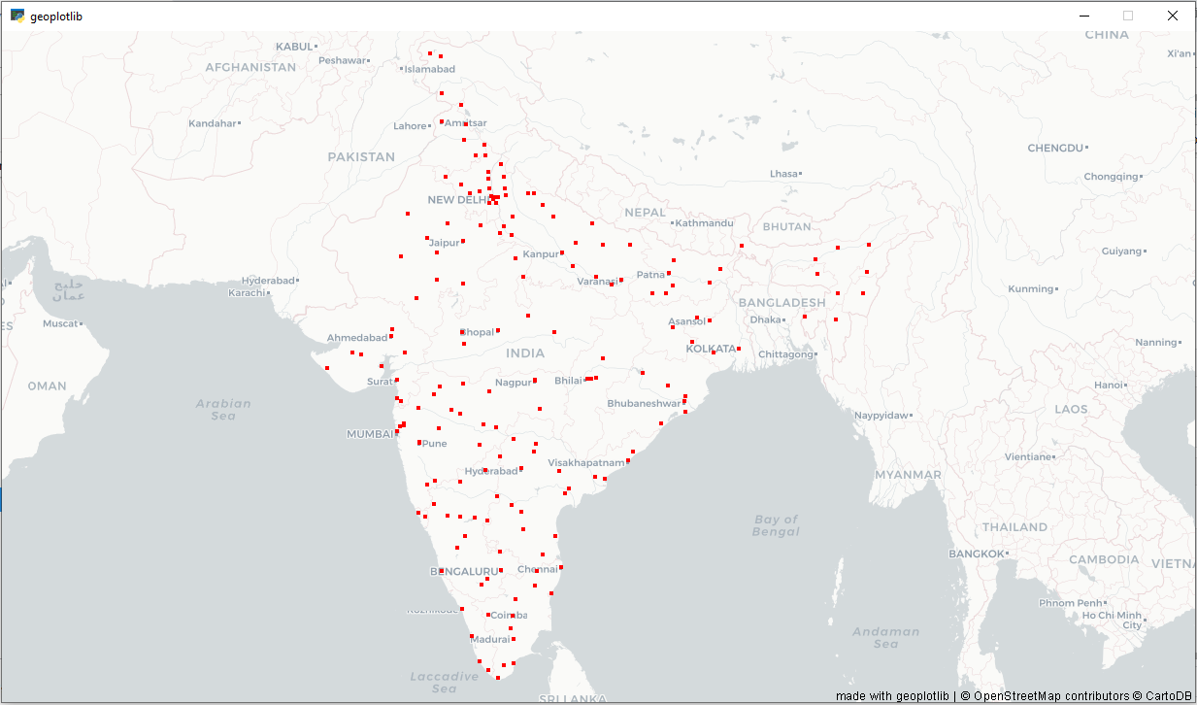
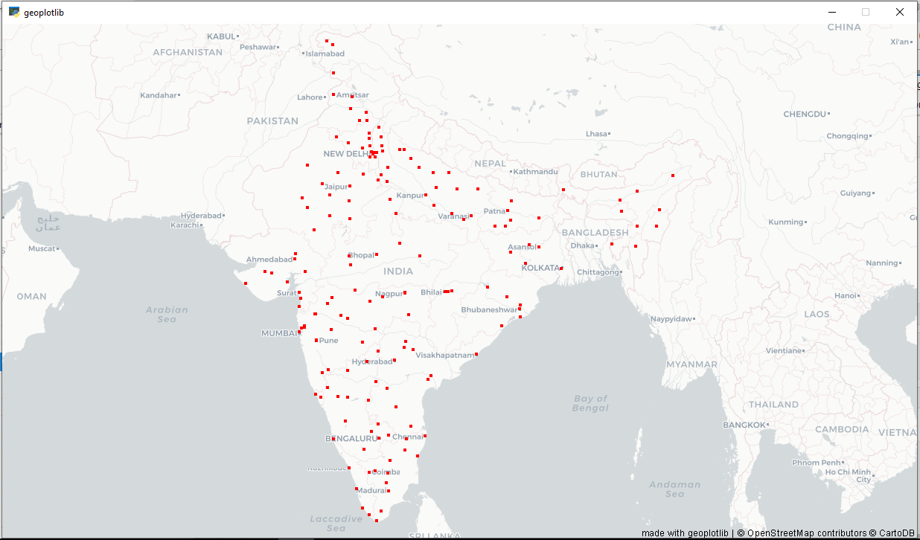
Tweet dot map
BJP
Congress

Slide 14
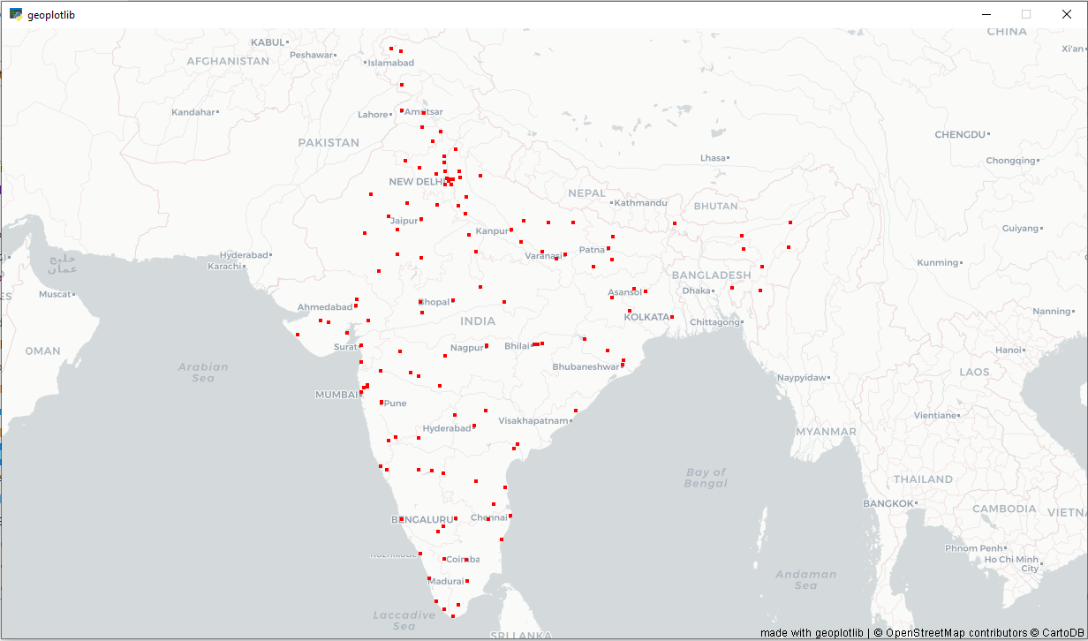

Positive Tweets Dot map
BJP
Congress

Slide 15
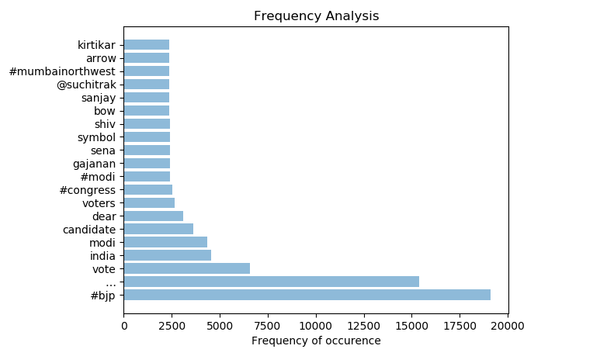
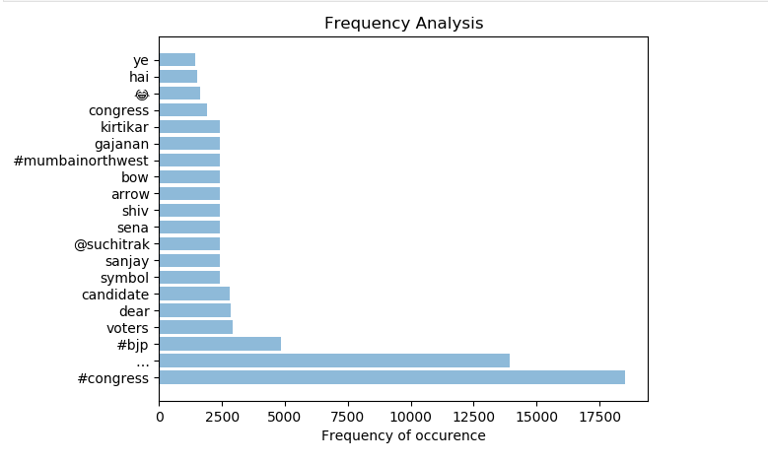
Frequently Occurring Words
BJP
Congress

Slide 16
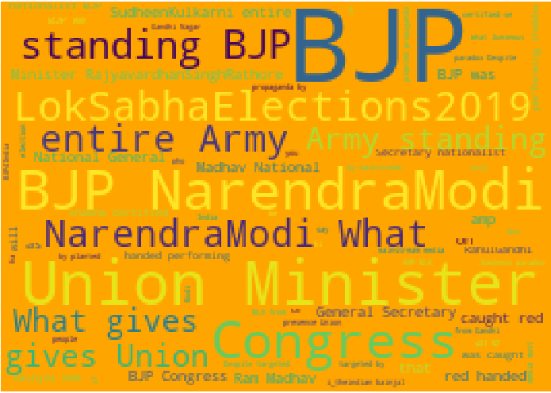
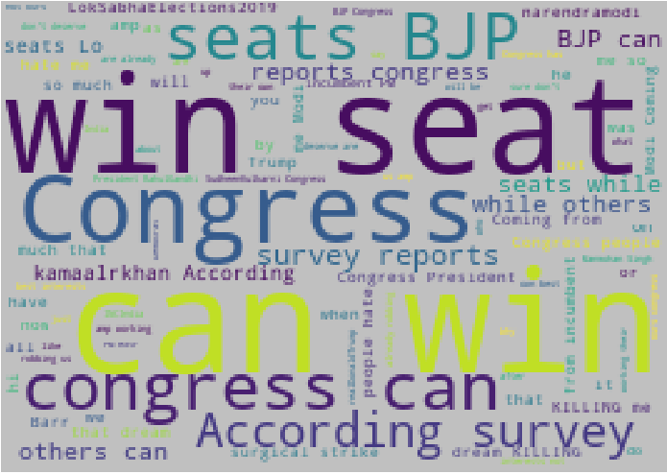
Word Cloud
BJP
Congress

Slide 17
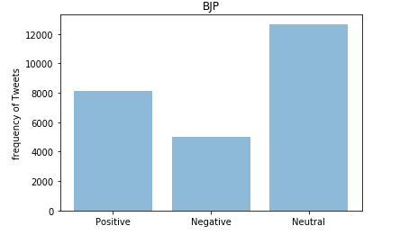
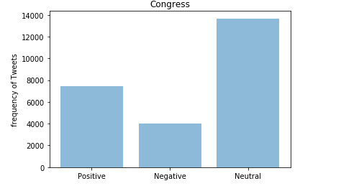
Frequency of positive and negative tweets
BJP
Congress

Slide 18
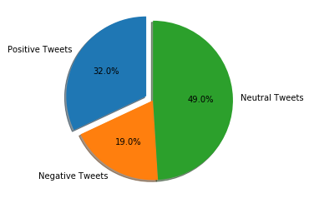
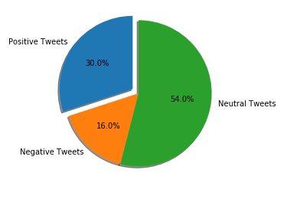
Frequency of positive and negative tweets
BJP
Congress

Slide 19
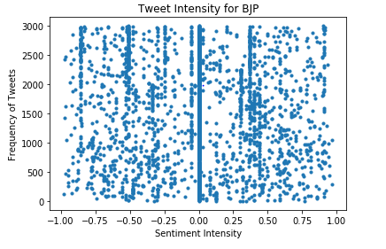
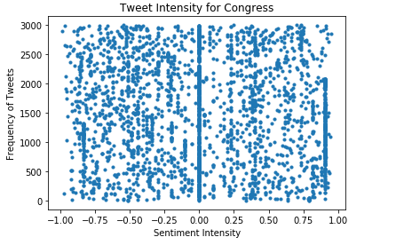
Sentiment Intensity Analysis
BJP
Congress

Slide 20
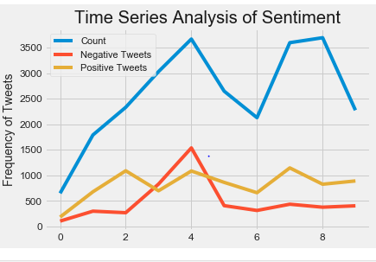
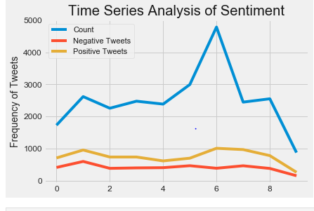
Time Series Analysis of Sentiment
BJP
Congress

Slide 21
Evaluation
Witnessed a disoriented narrative of congress supporters based on the cluster analysis
The voters of each party are not divided on provincial lines
The supporters of congress are loyal to the legacy of the party
However, the voters of BJP are also attached to the candidate name
Congress politics revolved more around the anti-campaigning of BJP

